Slide 1


Data WareHousing With IBM Cloud Db 2
Naan Mudhalvan
Presented By:- Indranil Bakshi

Slide 2


ABOUT TH CLOUD DB2
IBM® Db2® is a cloud-native database built on decades of expertise in bringing data governance and security, low-latency transactions and continuous availability to your mission critical data, analytics and AI-driven applications. With support for mixed transactional and analytical workloads,
IBM Naan Mudhalvan

Slide 3

STAGES TO IMPLEMENT
Zenith Central Bank
Stage 1
Stage 4
Choose the Domain for implementation of DatawareHousing
02
Make the Document for Storing the Data
03
a
Stage 2
Stage 5
01
Collect the Data From your Organization and network resources
06
Giving access for the Data to particular Authenticate Entity
04
Stage 3
Stage 6
05
Create a Account in Cloud Db
End

Slide 4
Data Flow Of WareHousing Architecture
Compnay
Providing The Data
Model Building
Ai Training
Analysis
Cloud DB
Organization1
Our Organization

Slide 5
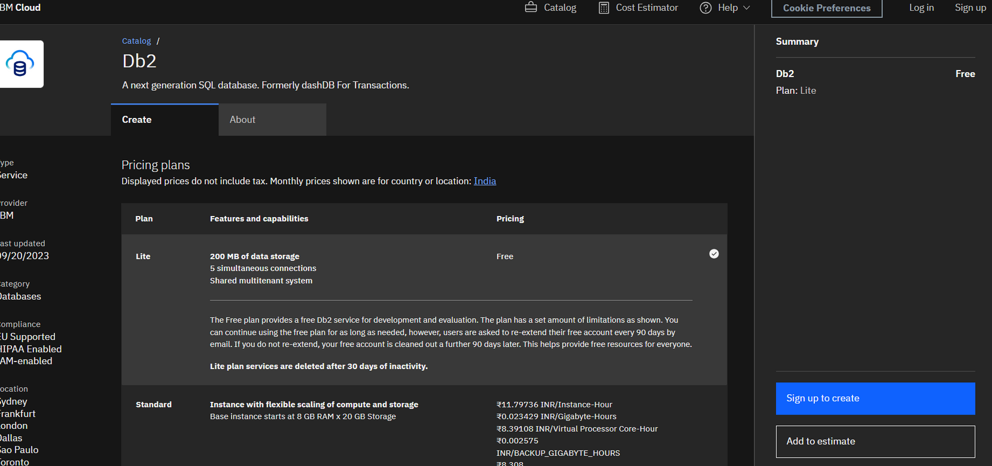
We need to Fill our all credentials to create a account

Slide 6

Providing Security
Advantages of Cloud Db2
its providing the high level of security for stored data
Access Control
Naan Mudhalvan
Use visual charts to communicate
info more effectively.
Reliability
we can fully rely with the Datta stored into cloud
24x7 Data availability
Use visual charts to communicate
info more effectively.

Slide 7
Thank You!
Naan Mudhalvan

